Slide 1
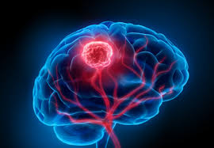
BRAIN TUMOR PREDICTION USING MRI IMAGES

Slide 2
Index
Introduction of Team members
Road Map
Advantages and Disadvantages
Conclusion
References

Slide 3
Team Name: BIET-TEAM16
Nandini B
Gousiya Banu I
Harshita J R
Tejaswini Manne
Rakshitha T M

Slide 4
Introduction
The brain tumors, are the most common and aggressive disease, leading to a very short life expectancy in their highest grade. Here, automatic brain tumor detection is proposed by using Convolutional Neural Networks (CNN) classification.

Slide 5
Road Map
2.Data
Collection
4.Model
Design
3.Data
Pre-processing
1.Work
Distribution
5.Application
Design

Slide 6
Data Collection
We have used brain tumor dataset from Kaggle provided in the description of the problem.

Slide 7
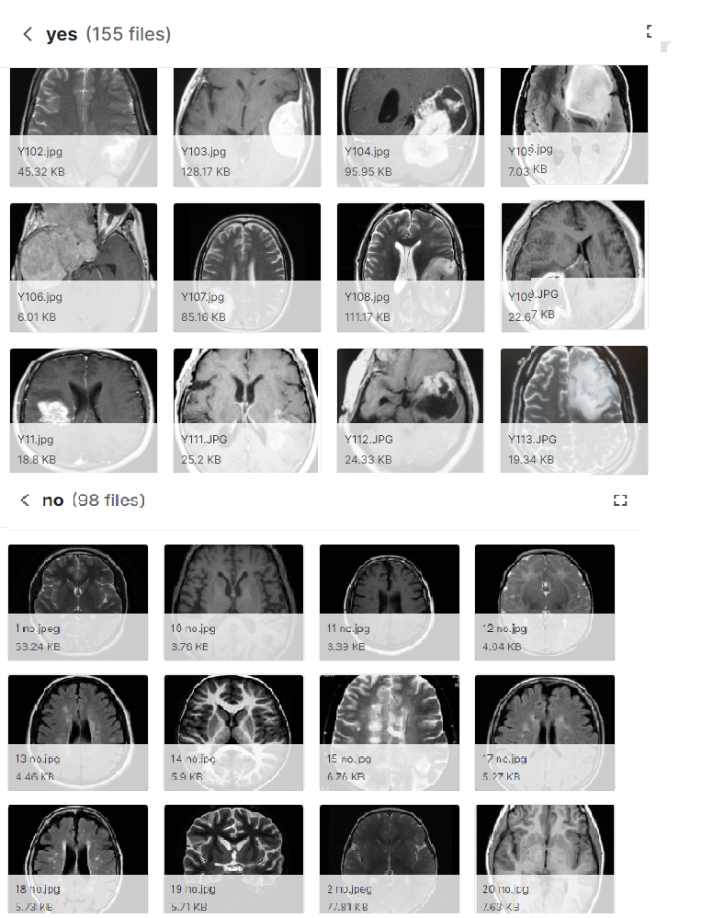
Brain Tumor Dataset

Slide 8
Data pre-processing
Step 1: Importing ImageDataGenerator library
Step2:Configuring ImageDataGenerator class
Step3 : Applying ImageDataGenerator Functionality to Trainset and Testset

Slide 9
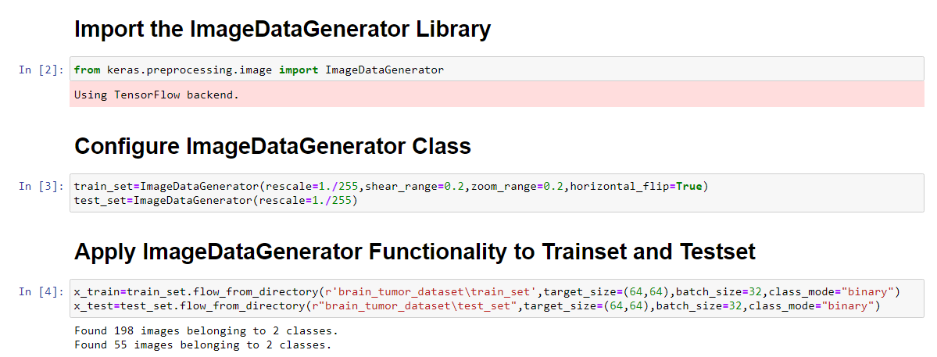
Code Screenshot

Slide 10
Model Design
Step 1: We have used the Keras Sequential API, where we have to add one layer at a time, starting from the input
Step 2: Adding convolutional (Conv2D) layer. It is like a set of learnable filters. We chose to set 32 filters for the two firsts conv2D layers and 64 filters for the two last ones. Each filter transforms a part of the image (defined by the kernel size) using the kernel filter. The kernel filter matrix is applied on the whole image. Filters can be seen as a transformation of the image.
Step 3: Adding the second important layer in CNN is the pooling (MaxPool2D) layer. This layer simply acts as a downsampling filter. It looks at the 2 neighbouring pixels and picks the maximal value. These are used to reduce computational cost, and to some extent also reduce overfitting.

Slide 11
Model Design
Step 4- Adding the Flatten layer is use to convert the final feature maps into a one single 1D vector. This flattening step is needed so that you can make use of fully connected layers after some convolutional/maxpool layers.
Step 5:In the end we used the features in two fully-connected (Dense) layers which is just artificial an neural networks (ANN) classifier
.
Step 6: Once layers are added to the model, we need to set up a score function, a loss function and an optimisation algorithm and compile the model.
Step 7:Fit the model into x_train and finally save the model.

Slide 12
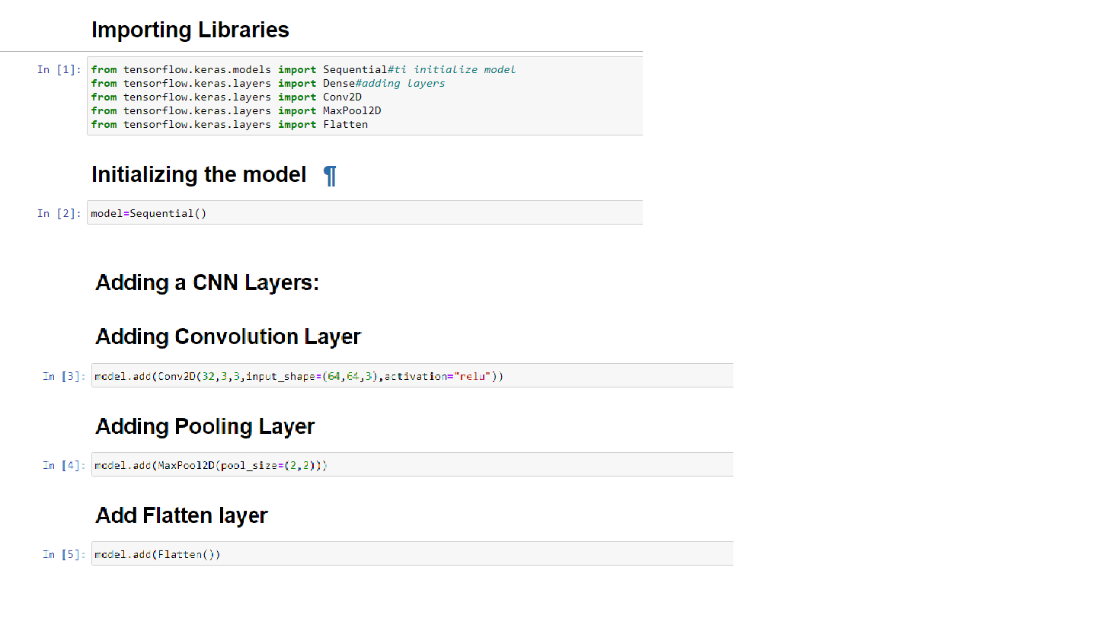
Screenshot of CNN Model code

Slide 13
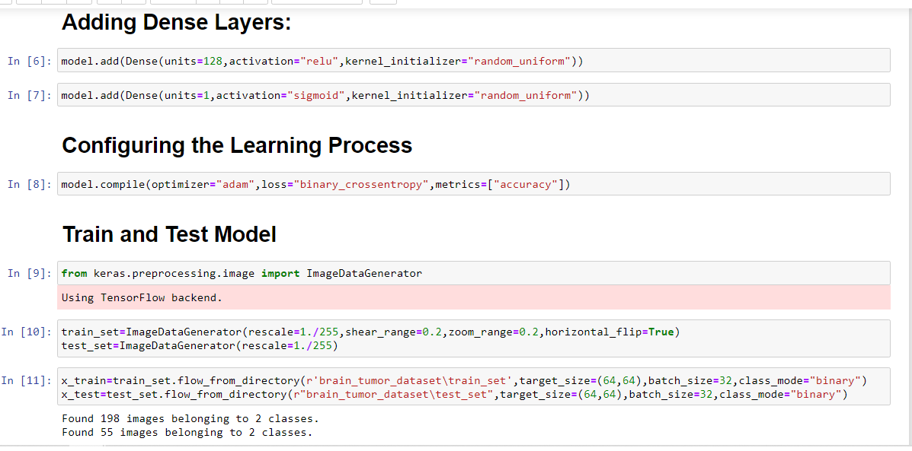
Screenshot of CNN model code

Slide 14
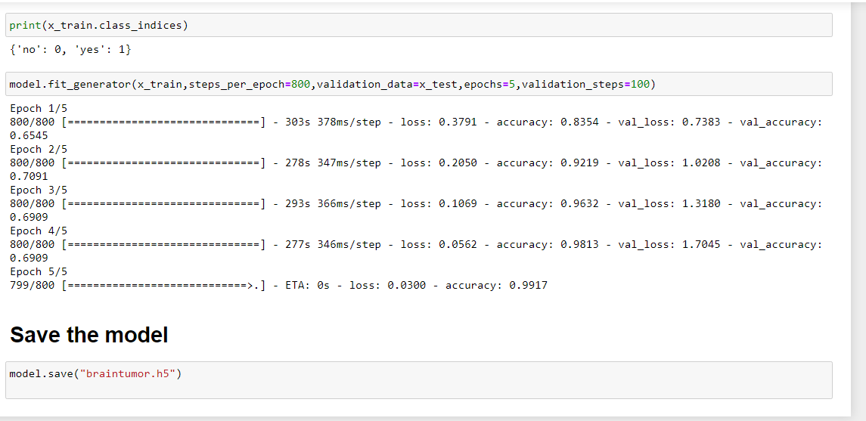
Screenshot of CNN model code

Slide 15
Application Design
We have used HTML ,CSS and Javascript for front end and flask for backend.

Slide 16
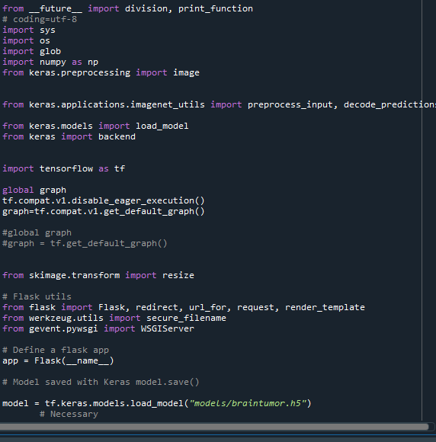
Screenshot of flask app code

Slide 17
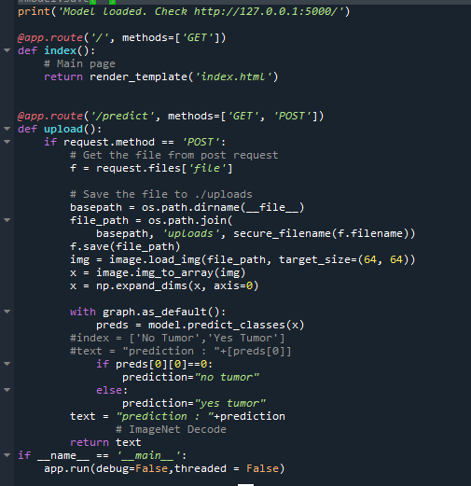
Screenshot of flask app code

Slide 18
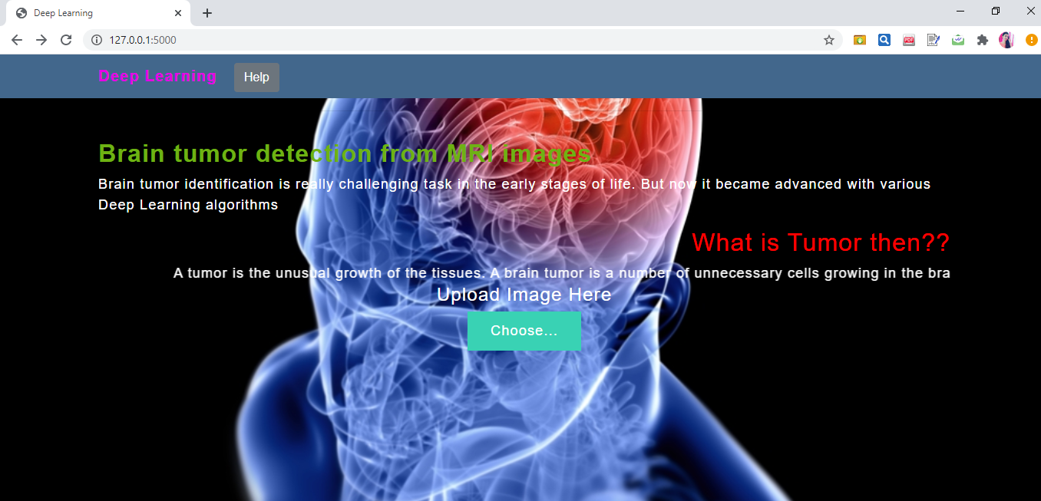
Screenshot of App Page

Slide 19
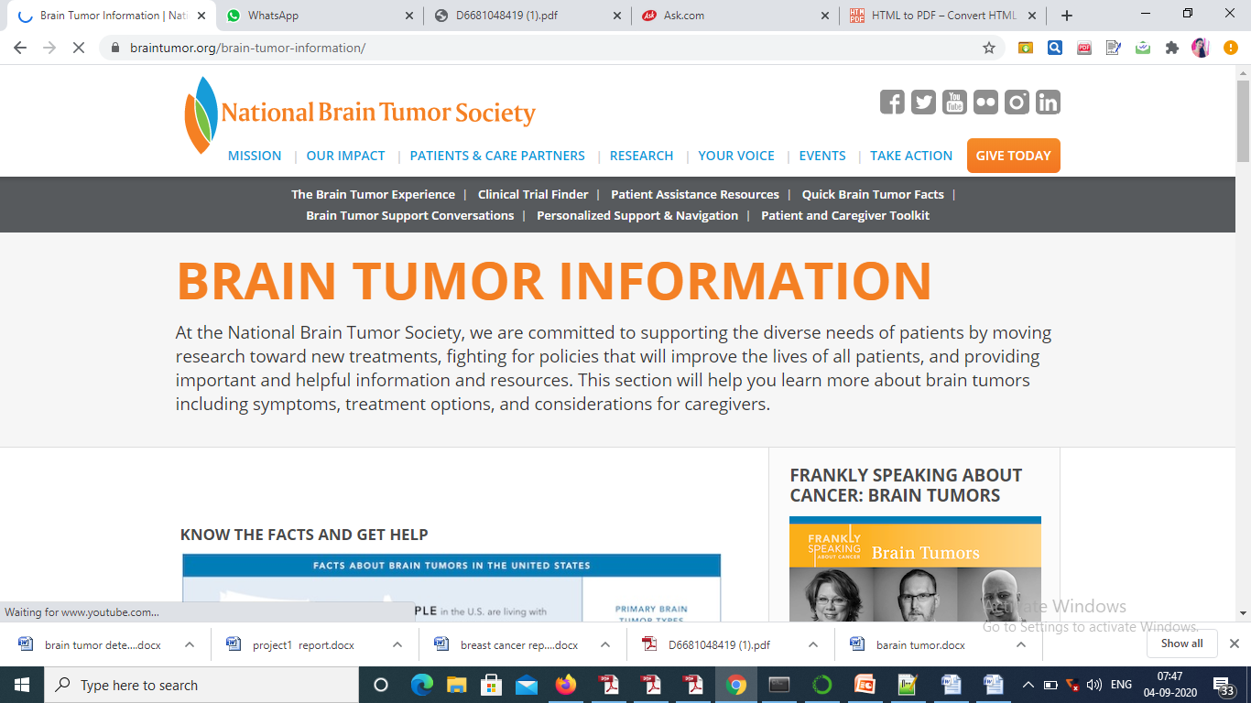
Screenshot of Help Page

Slide 20
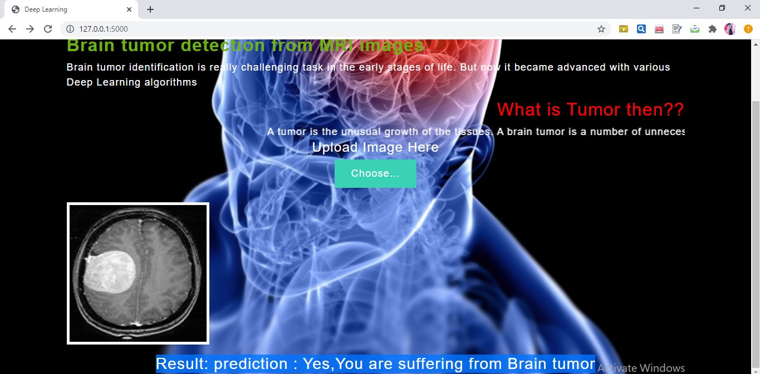
Screenshot of Prediction

Slide 21
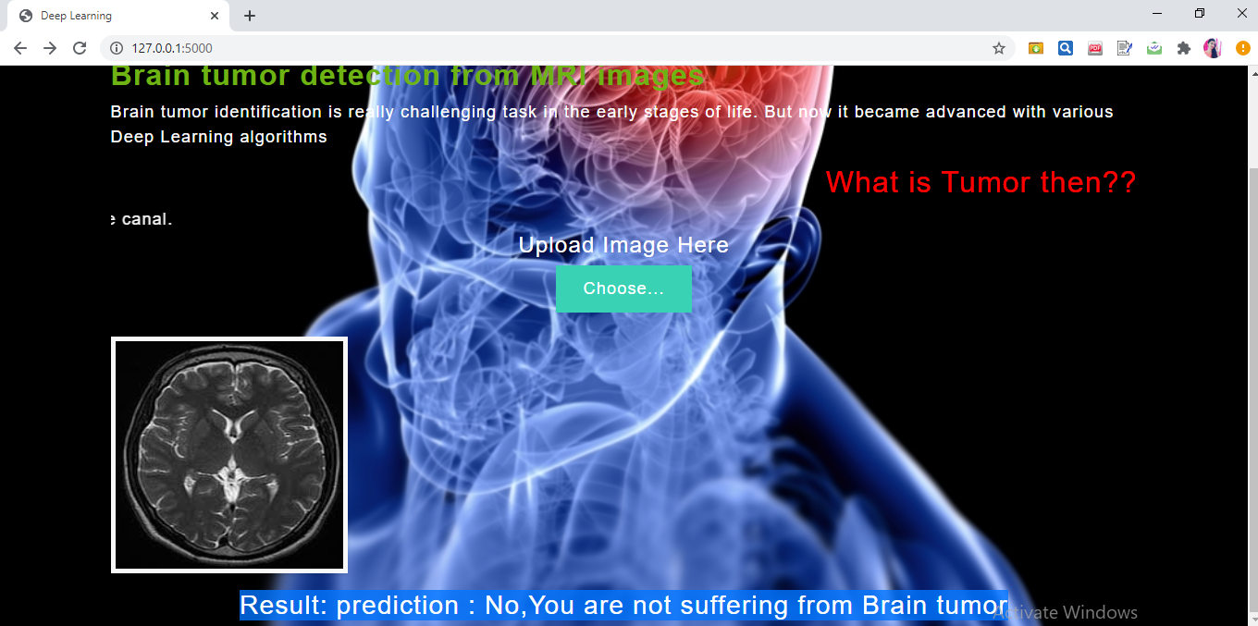
Screenshot of prediction

Slide 22
Advantages and Disadvantages
Advantages:
1.Brain tumor detection is easy to implement and understand.
2.it operate in real-time due to low time complexity.
3.it is applicable in training and test-time
4.deliver invariance with respect to the lesion position,scale,and rotation.
Disadvantages:
1.it produces correlated images.
2.it easily generate anatomically incorrect examples

Slide 23
Conclusion
This projects consists of the details about the model which was used for the detection of brain tumor using the MRI images of the brain from the normal persons and the persons who had a brain tumor. From the resultant graphs, it is proven that the accuracy of the model has reached good level, if it is deployed in the real-time scenario then it will help many people in diagnosing the brain tumor without wasting the money on check-up. If the brain tumor is confirmed by the model, then the person can reach the nearest hospital to get the treatment. It can be the best way of practice for people to save money. As we know that the data plays a crucial role in every deep learning model, if the data is more specific and accurate about the symptoms of the brain tumor then that can help in reaching greater accuracy with better results in real-time applications.

Slide 24
Thank You

